Slide 1


Capstone Project - The Battle of Neighborhoods
Finding a Better Place in Scarborough, Toronto

Slide 2

1. Introduction
Toronto is the largest city in Canada, the capital of the province of Ontario
The population of the metropolitan area (census area) increased from 4.1 million in 1992 to 5.6 million in 2011
* The Greater Toronto Area had more than 6.2 million in 2010.

Slide 3
Business Problems:
The main purpose of this project is to propose a better neighborhood in a new city for people moving there. Social presence in society about like-minded people. Connect to the airport, bus stop, city center, markets, and other daily necessities nearby.
List sorted of houses by housing price in ascending or descending order
Sort the list of schools by location, fee, rating, and rating

Slide 4
2. Data Section
Data Source: I will reuse the data source already implemented in the project in Week 3 Data Link: https://en.wikipedia.org/wiki/List_of_postal_codes_of_Canada:_M
Foursquare API:
Neighborhood
Neighborhood latitude
Neighborhood longitude
Venue
Name of the venue e.g. the name of a store or restaurant
Venue Latitude
Venue Longitude
Venue Category

Slide 5
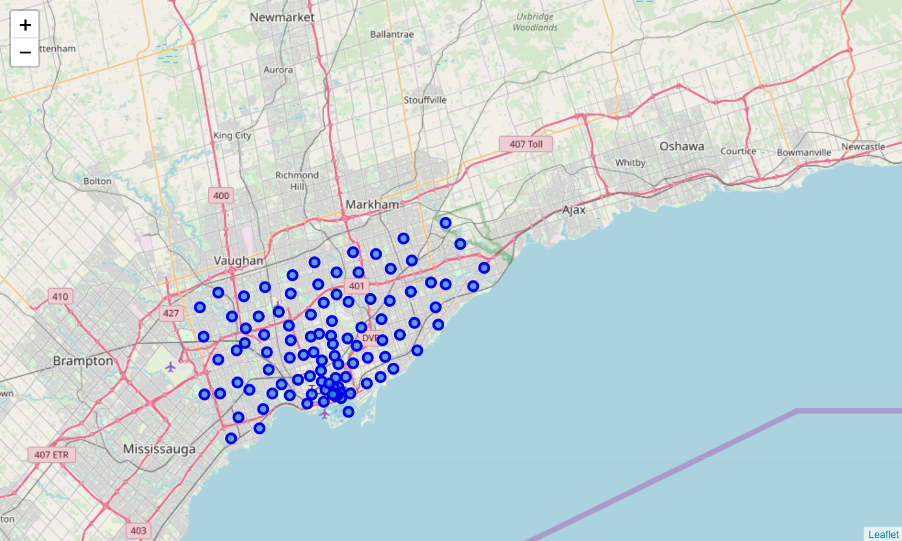
3. Methodology Section
Scarborough is a popular destination for new immigrants in Canada to reside in. As a result, it is one of the most multicultural and multicultural areas in the Greater Toronto Area, home to various religious groups and places of worship. Although immigration has become a hot topic in the past few years with many governments seeking more restrictions on immigrants and refugees, the general trend of immigration into Canada is one of the increases.
Map of Scarborough

Slide 6
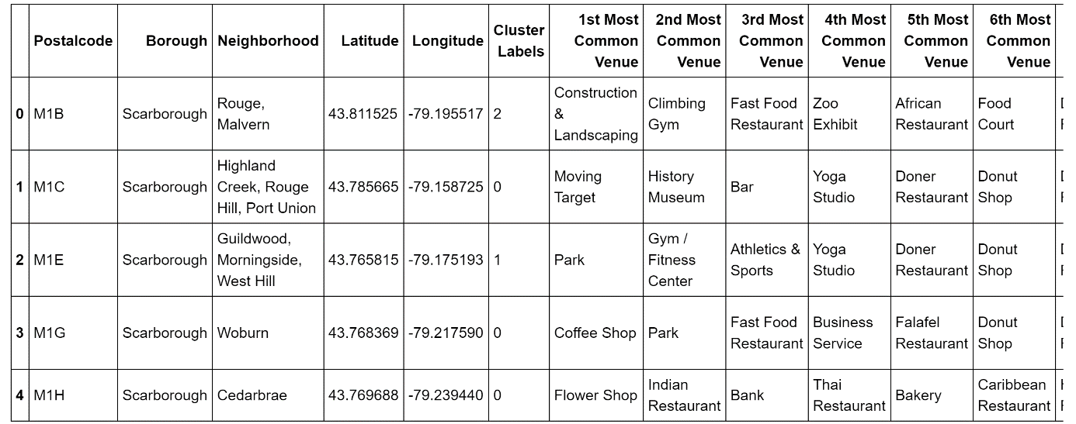
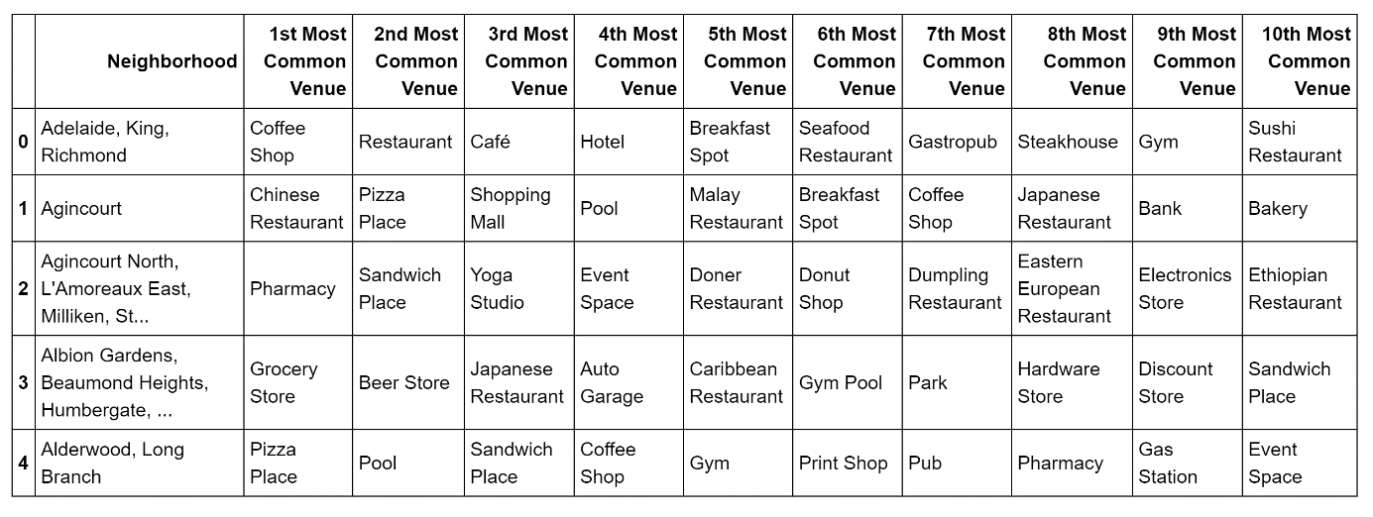
3. Methodology Section
Using K-Means Clustering Approach
Most Common venues near Neighborhood

Slide 7
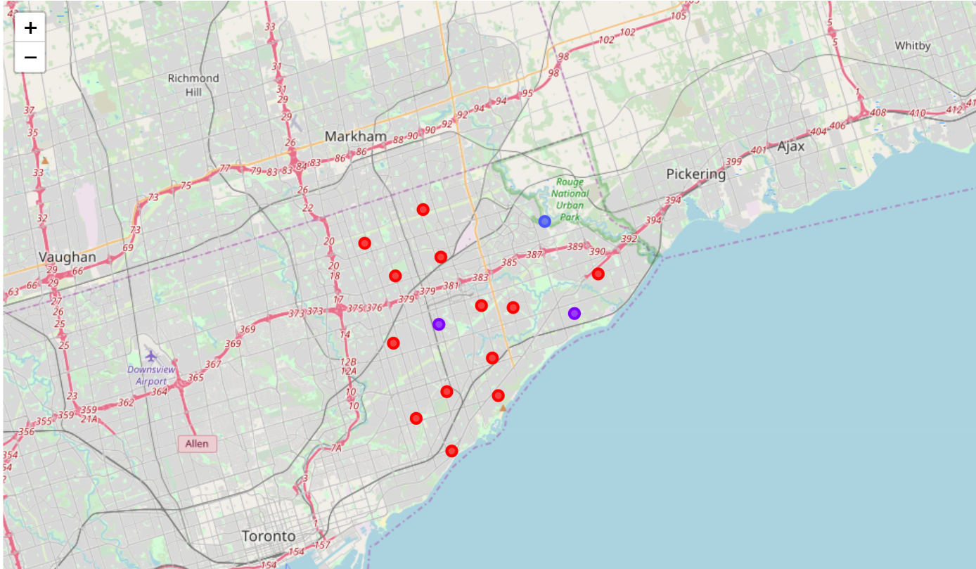
4. Results Section
Map of Clusters in Scarborough

Slide 8
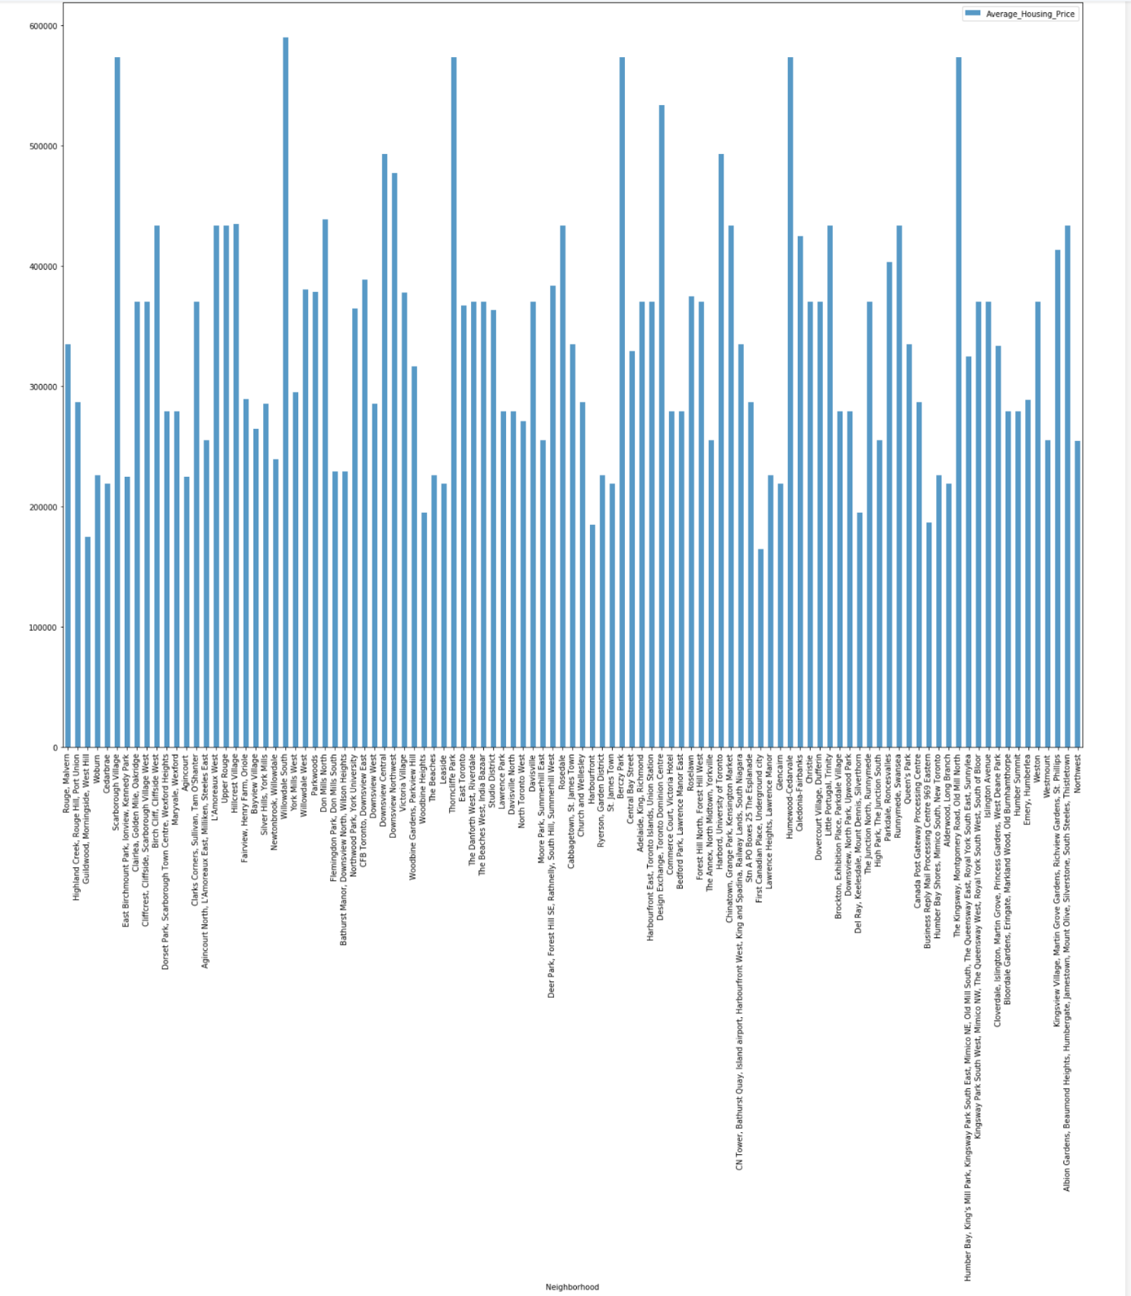
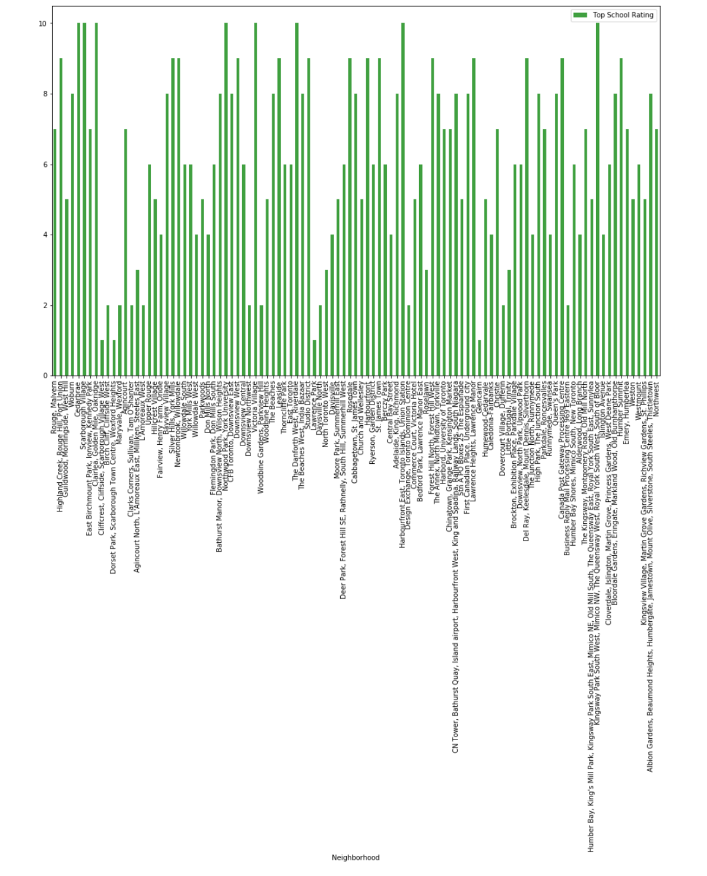
4. Results Section
Average Housing Price by Clusters in Scarborough School Ratings by Clusters in Scarborough

Slide 9
4. Conclusion Section
Using k-means cluster algorithm, I separated the neighborhood into 10(Ten) different clusters and for 103 different lattitude and logitude from dataset
Using the charts above results presented to a particular neighborhood based on average house prices and school rating

